Slide 1
SO-CHIC: South Ocean Carbon and Heat Impact on Climate

Slide 2
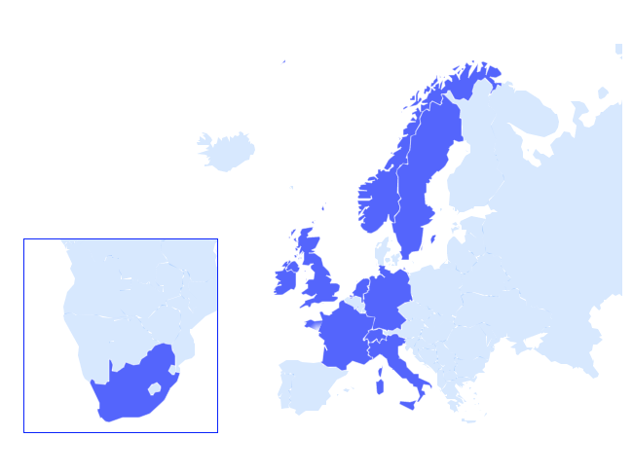
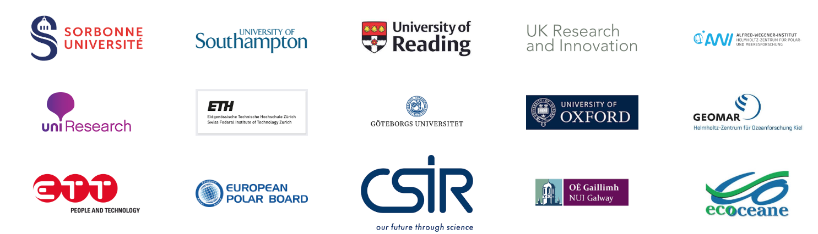
General information
H2020 Research & Innovation Action
European Commission Societal challenge 5 on « Climate Actions »
  15 partners from 10 different countries
    Coordinator: JB Sallée at Sorbonne Université
Start |  | End | Maximum EC contribution | EU reimbursement rate
01/11/2019 | 48 months | 31/10/2013 | € 7,989,925 | 100%

Slide 3
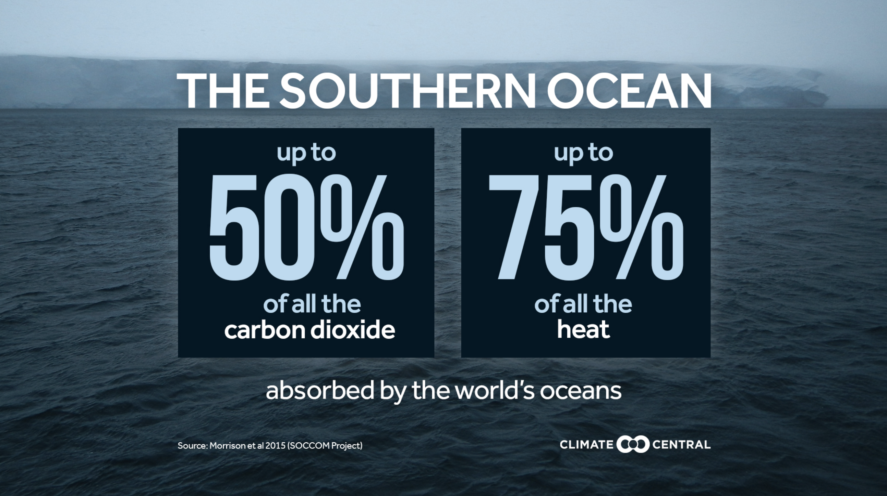
Objective
To understand and quantify variability of heat and carbon budgets in the Southern Ocean
  Huge climate regulation role poorly understood and represented in climate models

Slide 4
Specific objectives
  O1:
    To initiate a sustained monitoring of budgets of heat and carbon in the Southern Ocean, by quantifying their fluxes at the air-sea-ice interface and estimating interannual variability of heat and carbon storage in the Southern Ocean.
  O2:
    To improve understanding of the spatial distribution and variability of heat and carbon exchanges between the atmosphere and the deep ocean, focusing on the dynamics of the ocean mixed-layer, its relation to sea ice distribution, and on assessing what has caused the opening of the open-ocean Weddell Polynya in 2016 and 2017 (i.e. a large-scale ice-free area within closed sea-ice cover), more than 40 years after its previous occurrence.

Slide 5
Specific objectives
  O3:
    To improve understanding of the formation and export of bottom waters in the Bottom Boundary Layer, which ventilate the world’s abyssal oceans, and to propose new strategies to represent such key processes, which are major shortcomings of current state of the art climate models.
  O4:
    To identify critical sensitivities in the Southern Ocean climate system that must be correctly represented in models in order to significantly reduce uncertainties in future projections of oceanic heat and carbon content.
  O5:
    To enable free and open access to all data and to maximise impact on the climate report (IPCC), climate services, and climate-model groups.

Slide 6
Concept

Slide 7
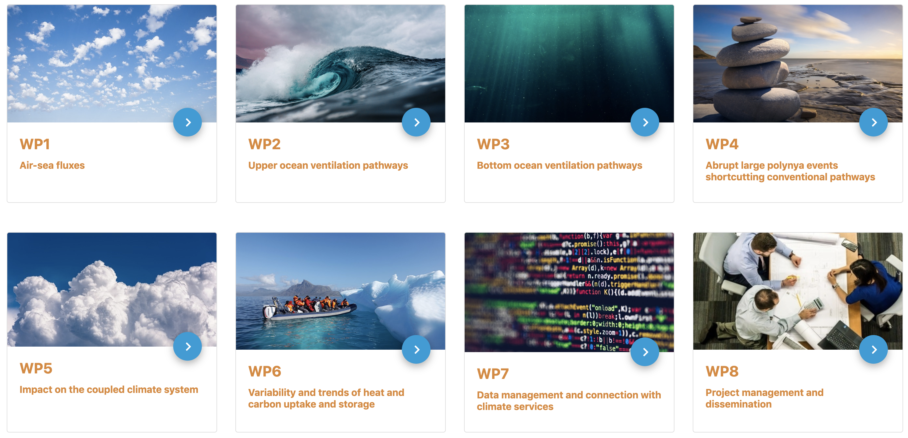
Project architecture

Slide 8
The SO-CHIC Project
Advisory Board
Key Processes
WP1 : Air-Sea fluxes
WP2 : Upper ocean ventilation pathway
WP3 : Deep ocean ventilation pathway
WP4 : Abrupt large Polyna events shortcutting conventional pathways
WP7 : Data Management and connection to climate services
Users & Stakeholders
WP5 : Impact on the coupled climate system
Data Management
WP6 : Variability and trends of heat and carbon uptake and storage
Feedback
WP8 : Management and Dissemination

Slide 9
THANK YOU

